Slide 1


Department of Computer Science

Slide 2

Definition
“An operator is a symbol (+,-,*,/) that directs the computer to perform certain mathematical or logical manipulations and is usually used to manipulate data and variables”
Ex: a+b

Slide 3

Operators in C
Arithmetic operators
Relational operators
Logical operators
Assignment operators
Increment and decrement operators
Conditional operators
Bitwise operators
Special operators

Slide 4

Arithmetic operators
Operator | example | Meaning
+ | a + b | Addition –unary
- | a – b | Subtraction- unary
* | a * b | Multiplication
/ | a / b | Division
% | a % b | Modulo division- remainder

Slide 5

Relational Operators
Operator | Meaning
< | Is less than
<= | Is less than or equal to
> | Is greater than
>= | Is greater than or equal to
== | Equal to
!= | Not equal to

Slide 6

Logical Operators
Operator | Meaning
&& | Logical AND
|| | Logical OR
! | Logical NOT
Logical expression or a compound relational expression-
An expression that combines two or more relational expressions
Ex: if (a==b && b==c)

Slide 7

Truth Table
a | b | Value of the expression
 |  | a && b | a || b
0 | 0 | 0 | 0
0 | 1 | 0 | 1
1 | 0 | 0 | 1
1 | 1 | 1 | 1

Slide 8
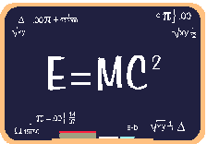
Assignment operators
Syntax:
v op = exp;
Where v = variable,
op = shorthand assignment operator
exp = expression
Ex: x=x+3
x+=3

Slide 9

Shorthand Assignment operators
Simple assignment operator | Shorthand operator
a = a+1 | a + =1
a = a-1 | a - =1
a = a* (m+n) | a * = m+n
a = a / (m+n) | a / = m+n
a = a %b | a %=b

Slide 10

Increment & Decrement Operators
C supports 2 useful operators namely
Increment ++
Decrement – operators
The ++ operator adds a value 1 to the operand
The – operator subtracts 1 from the operand
++a or a++
--a or a--

Slide 11

Rules for ++ & -- operators
These require variables as their operands
When postfix either ++ or –– is used with the variable in a given expression, the expression is evaluated first and then it is incremented or decremented by one
When prefix either ++ or –– is used with the variable in a given expression, it is incremented or decremented by one first and then the expression is evaluated with the new value

Slide 12

Examples for ++ & -- operators
Let the value of a =5 and b=++a then
a =6 and b =6
Let the value of a = 5 and b=a++ then
a =6 but b=5
i.e.:
1. a prefix operator first adds 1 to the operand and then the result is assigned to the variable on the left
2. a postfix operator first assigns the value to the variable on left and then increments the operand.

Slide 13

Conditional operators
Syntax:
exp1 ? exp2 : exp3
Where exp1,exp2 and exp3 are expressions
Working of the ? Operator:
Exp1 is evaluated first, if it is nonzero(1/true) then the expression2 is evaluated and this becomes the value of the expression,
If exp1 is false(0/zero) exp3 is evaluated and its value becomes the value of the expression
Ex: m=2;
n=3
r=(m>n) ? m : n;

Slide 14

Bitwise operators
These operators allow manipulation of data at the bit level
Operator | Meaning
& | Bitwise AND
| | Bitwise OR
^ | Bitwise exclusive OR
<< | Shift left
>> | Shift right

Slide 15

Special operators
Comma operator ( ,)
sizeof operator – sizeof( )
Pointer operators – ( & and *)
Member selection operators – ( . and ->)

Slide 16


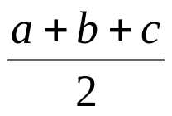
Arithmetic Expressions
Algebraic expression | C expression
axb-c | a*b-c
(m+n)(x+y) | (m+n)*(x+y)
 | a*b/c
3x²+2x+1 | 3*x*x+2*x+1
 | a/b
 | S=(a+b+c)/2
S=

Slide 17

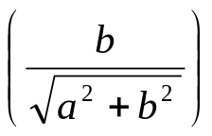
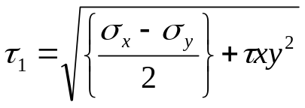
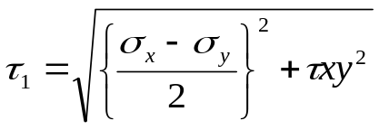
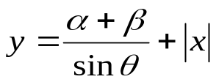
Arithmetic Expressions
Algebraic expression | C expression
area= | area=sqrt(s*(s-a)*(s-b)*(s-c))
 | sin(b/sqrt(a*a+b*b))
 | tow1=sqrt((rowx-rowy)/2+tow*x*y*y)
 | tow1=sqrt(pow((rowx-rowy)/2,2)+tow*x*y*y)
 | y=(alpha+beta)/sin(theta*3.1416/180)+abs(x)
Sin

Slide 18
Precedence of operators
Brackets will have the highest precedence and have to be
evaluated first, then comes of , then comes
division, multiplication, addition and finally subtraction.
C language uses some rules in evaluating the expressions
and they r called as precedence rules or sometimes also
referred to as hierarchy of operations, with some operators
with highest precedence and some with least.
The 2 distinct priority levels of arithmetic operators in c are-
Highest priority : * / %
Lowest priority : + -

Slide 19
Rules for evaluation of expression
First parenthesized sub expression from left to right are evaluated.
If parentheses are nested, the evaluation begins with the innermost sub expression
The precedence rule is applied in determining the order of application of operators in evaluating sub expressions
The associatively rule is applied when 2 or more operators of the same precedence level appear in a sub expression.
Arithmetic expressions are evaluated from left to right using the rules of precedence
When parentheses are used, the expressions within parentheses assume highest priority

Slide 20
Hierarchy of operators
Operator | Description | Associativity
( ), [ ] | Function call, array element reference | Left to Right
+, -, ++, - -,!,~,*,& | Unary plus, minus, increment, decrement, logical negation, 1’s complement, pointer reference, address | Right to Left
*, / , % | Multiplication, division, modulus | Left to Right

Slide 21
Example 1
Evaluate x1=(-b+ sqrt (b*b-4*a*c))/(2*a) @ a=1, b=-5, c=6
=(-(-5)+sqrt((-5)(-5)-4*1*6))/(2*1)
=(5 + sqrt((-5)(-5)-4*1*6))/(2*1)
=(5 + sqrt(25 -4*1*6))/(2*1)
=(5 + sqrt(25 -4*6))/(2*1)
=(5 + sqrt(25 -24))/(2*1)
=(5 + sqrt(1))/(2*1)
=(5 + 1.0)/(2*1)
=(6.0)/(2*1)
=6.0/2 = 3.0

Slide 22
Example 2
Evaluate the expression when a=4
b=a- ++a
=a – 5
=5-5
=0

Slide 23



